Slide 1
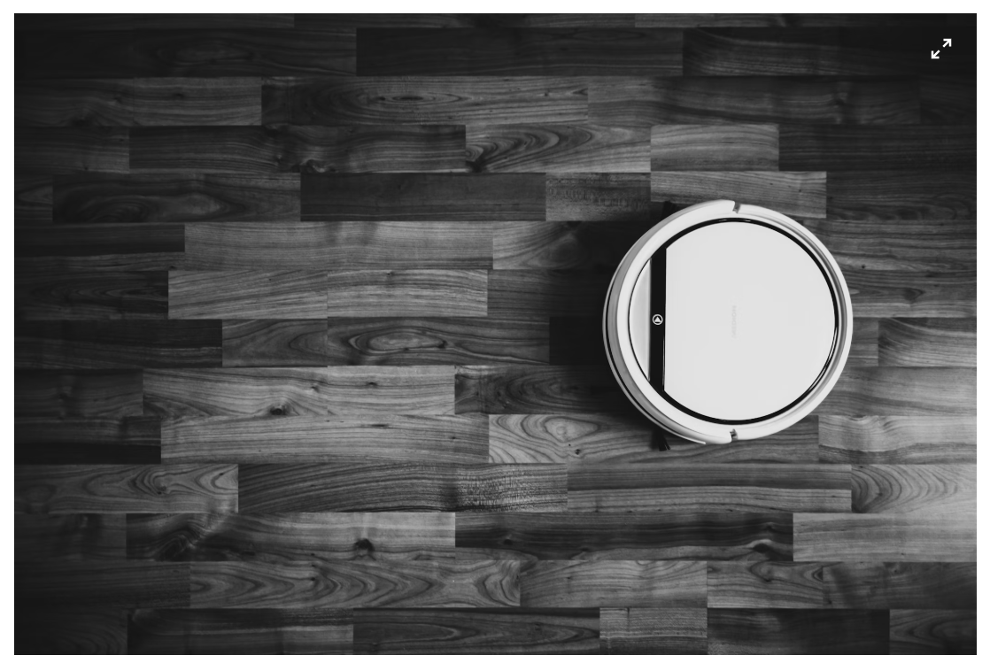
HOW DOES ROBOT VACUUM CLEANER WORKS

Slide 2
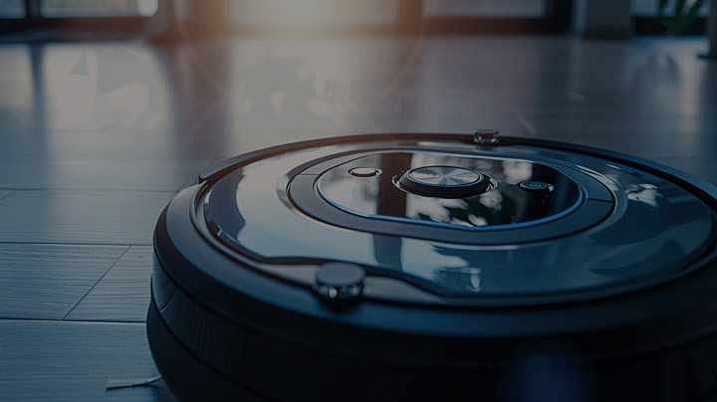
INTRODUCTION
Robot vacuums took the tediousness out of cleaning by automation, saving time and convenience.
Cleaning efficiency in the Robot Vacuum involves comprehensive floor cleaning, obstacle navigation, and maintenance of hygiene in areas that are usually impossible to reach.
It's a perfect cleaner for very busy households with better hygiene as well as reduced physical labor.

Slide 3
EXPLANATION :
#include <iostream>: Lets you display output (e.g., `cout`) and take input (e.g., `cin`).
#include <cstdlib>: Enables random number generation using `rand()` and `srand()`.
#include <ctime>: Provides `time()` to seed the random number generator for better randomness.
GRID_SIZE = 5: Sets the grid to 5 rows and 5 columns.
CLEAN = 0: Marks a clean cell.
DIRTY = 1: Marks a dirty cell that needs cleaning.
OBSTACLE = 2: Represents an obstacle (not used in this part).
CHARGING_STATION = 3: Marks the robot’s charging station (start and return point).
CODE:
#include <iostream>
#include <cstdlib>
#include <ctime>
using namespace std;
const int GRID_SIZE = 5;
const int CLEAN = 0;
const int DIRTY = 1;
const int OBSTACLE = 2;
const int CHARGING_STATION = 3;

Slide 4
int x, y: The robot's position on the 5x5 grid.
int battery: The robot's battery level (percentage).
int grid[GRID_SIZE][GRID_SIZE]: A 5x5 grid representing the environment, where each cell can be clean, dirty, an obstacle, or a charging station.
class Robot Vacuum {
private:
int x, y;
int battery;
int grid[GRID_SIZE][GRID_SIZE];

Slide 5
public:
Robot Vacuum() : x(0), y(0), battery(100) {
srand(time(0));
for (int i = 0; i < GRID_SIZE; ++i) {
for (int j = 0; j < GRID_SIZE; ++j) {
int random Value = rand() % 3;
grid[i][j] = random Value;
}
}
grid[0][0] = CHARGING_STATION;
}
Robot Vacuum(): Constructor to initialize the robot.
:x(0), y(0), battery(100): Sets position to `(0, 0)` and battery to 100%.
srand(time(0));: Seeds the random number generator for varied results.
Grid initialization loop: Randomly assigns clean, dirty, or obstacle values to the grid.
grid[0][0] = CHARGING_STATION:: Sets the starting position as the charging station.

Slide 6
void move() {
if (battery <= 0) {
cout << "Battery empty. Returning to charging station.\n";
return To Charging Station();
return;
}
int direction = rand() % 4;
switch (direction) {
case 0: if (x > 0) x--; break;
case 1: if (x < GRID_SIZE - 1) x++; break;
case 2: if (y > 0) y--; break;
case 3: if (y < GRID_SIZE - 1) y++; break; // Move down
}
battery -= 10; // Reduce battery
cout << "Moved to (" << x << ", " << y << "). Battery: " << battery << "%\n";
}
void move(): Starts the move function.
if (battery <= 0): Checks if the battery is empty.
return To Charging Station():: Sends the robot to recharge.
int direction = rand() % 4;: Chooses a random direction (0-3).
switch (direction): Determines movement:
case 0: Moves left if possible.
case 1: Moves right if possible.
case 2: Moves up if possible.
case 3: Moves down if possible.
battery -= 10;: Reduces battery by 10.

Slide 7
void clean()
if (grid[x][y] == DIRTY): Checks if the current cell is dirty.
cout << "Cleaning at (" << x << ", " << y << ")\n";: Prints the robot's cleaning action.
grid[x][y] = CLEAN;: Marks the cell as clean.
battery -= 5;: Reduces the battery by 5%.
void return To Charging Station()
x = 0; y = 0;: Sets the robot's position to (0, 0), the charging station.
battery = 100;: Recharges the battery to 100%.
cout << "Returned to charging station. Battery full at 100%\n";: Prints that the robot returned and recharged.
void clean() {
if (grid[x][y] == DIRTY) {
cout << "Cleaning at (" << x << ", " << y << ")\n";
grid[x][y] = CLEAN;
battery -= 5;
}
}
void return To Charging Station() {
x = 0;
y = 0;
battery = 100;
cout << "Returned to charging station. Battery full at 100%\n";
}

Slide 8
void run() { : Starts the method.
while (battery > 0) { : Loops while battery > 0.
clean(); : Cleans the current cell.
move(); : Moves the robot randomly.
if (battery <= 20) { : Checks if battery is low.
return To Charging Station():: Returns to charging station and recharges.
void run() {
while (battery > 0) {
clean();
move();
if (battery <= 20) {
cout << "Battery low! Returning to charging station.\n";
return To Charging Station();
}
}
cout << "All tasks completed.\n";
}
};

Slide 9
The main() function creates a Robot Vacuum object, starts its cleaning process with robot.run(), and ends the program. The robot moves randomly, cleans dirty spots, and recharges when the battery is low.
int main() {
Robot Vacuum robot;
robot.run();
return 0;
}

Slide 10
KEY FEATURES OF ROBOT VACUUM CLEANER
Autonomous Operation: Cleans automatically without human intervention.
Smart Navigation & Mapping: Uses sensors to map the area and plan efficient cleaning paths.
Scheduling: Set cleaning times for convenience.
Dirt Detection: Detects and cleans dirtier spots more thoroughly.
Obstacle Avoidance: Avoids furniture and obstacles to prevent damage.
Multiple Cleaning Modes: Adapts to different cleaning needs (spot, edge, deep cleaning).

Slide 11
Auto-Recharge & Resume: Returns to charging station when low on battery and resumes cleaning once recharged.
Floor Type Adaptation: Adjusts settings based on floor type (carpet, hardwood, etc.).
HEPA Filtration: Captures fine dust and allergens for cleaner air.
Wi-Fi & App Control: Control remotely via smartphone or voice assistants.
Self-Emptying Bins: Empties dustbin automatically at its charging station.
Compact Size: Easy to store and maneuver in tight spaces.
Battery Life: Lasts 60-120 minutes, recharges in 2-4 hours.
Edge Cleaning: Cleans along walls and edges with side brushes

Slide 12
: POTENTIAL ENHANCEMENTS
Efficient Pathfinding : Use algorithms (e.g., spiral, Z-pattern) for systematic, efficient cleaning instead of random movement.
Real-Time Obstacle Detection : Improve the robot’s ability to detect and avoid obstacles while navigating.
Smart Battery Usage: Optimize battery use by cleaning only necessary areas and recharging when needed.
Mapping & Memory: Allow the robot to map and remember areas to avoid cleaning the same spots repeatedly.

Slide 13
CONCLUSION
A robot vacuum cleaner autonomously cleans your floors, detecting dirty spots and using suction or brushes. It navigates the room, manages its battery, and returns to the charging station when needed.
Advancements in technology have made robot vacuums more efficient, with smarter navigation, better cleaning, and easier control via apps or voice commands, making home cleaning more convenient and hands-free.

Slide 14


